Slide 1
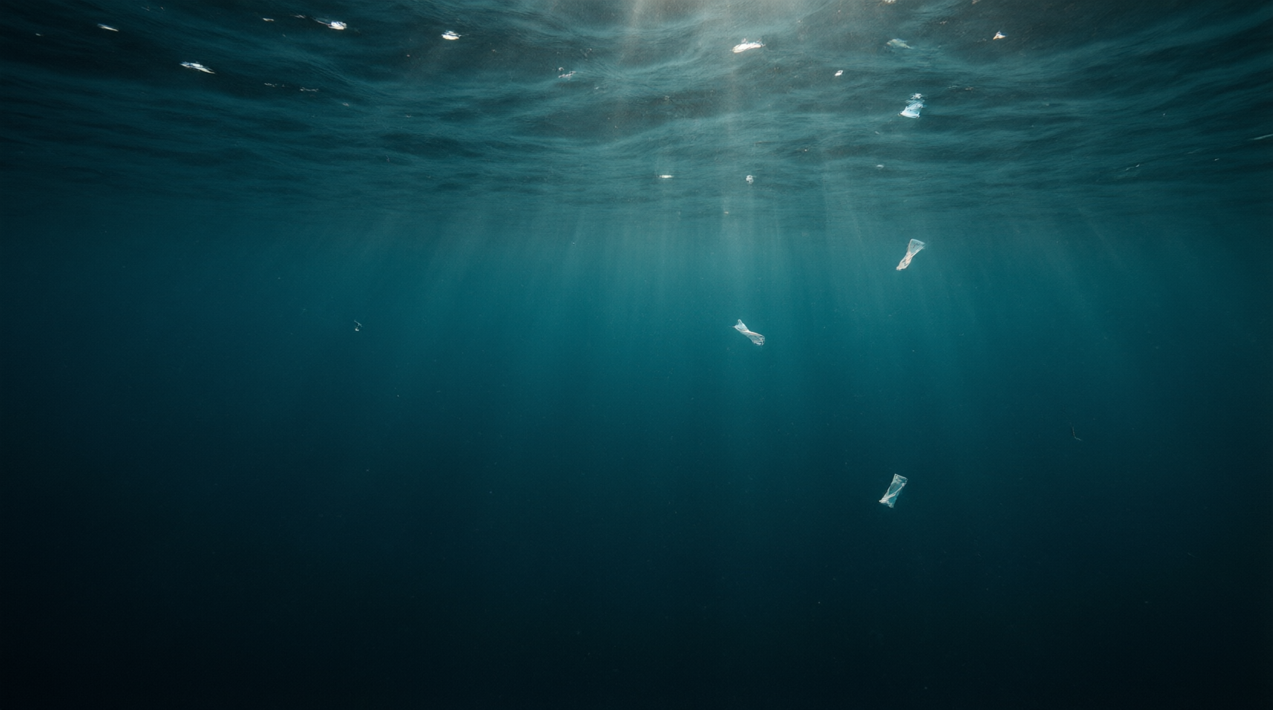

GROUP LITERATURE REVIEW
Microplastics on Our
Plates
Occurrence of Microplastics in Commercial Seafood under the
Perspective of the Human Food Chain
A group literature review of Mercogliano et al., J. Agric. Food Chem. 2020, 68, 5296-5301
Notes:
Welcome. Today our group reviews a 2020 review from the Journal of Agricultural and Food Chemistry about microplastics in the seafood we eat. We will follow one question: as plastic breaks down in the ocean, where does it end up - and what does that mean for us?

Slide 2
TABLE OF CONTENTS
Roadmap
01
Into the Food Web
How microplastics enter and move up the marine food chain
02
Which Seafood, and Why
Feeding strategies, occurrence levels and bioindicators
03
What It Means for Us
Human exposure, health effects and the research frontier
Notes:
We split the paper into three movements, like our four speakers: first how microplastics get into the food web, then which seafood carries them and why, and finally what that means for human health and for the science ahead.

Slide 3
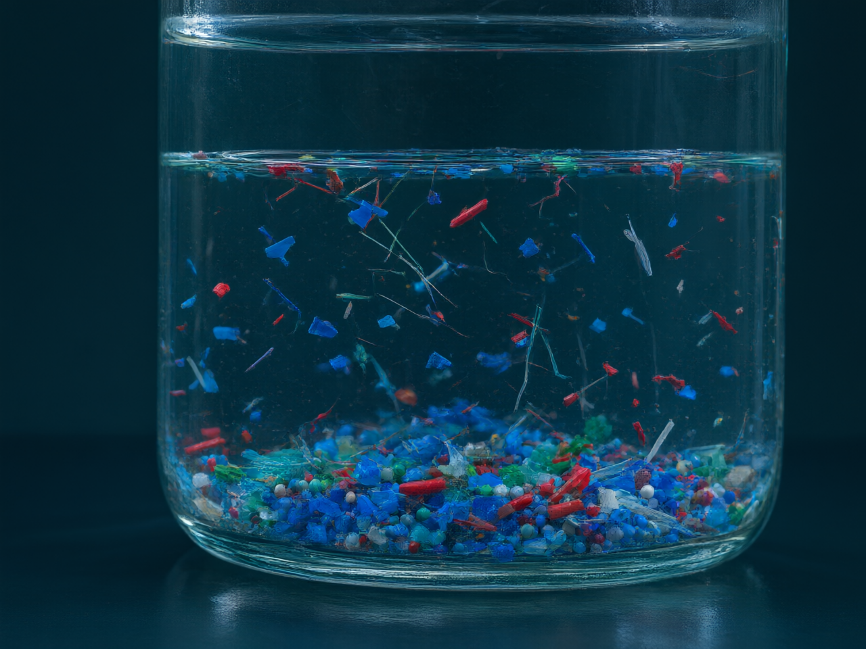
01
INTRODUCTION
The Central Claim
Microplastics are everywhere in the ocean, and seafood is a direct route to the human diet.
01
Definition: differently shaped plastic particles sized 0.1-5000 µm - fibres, fragments,
spheroids, beads, granules, pellets and flakes.
02
Two origins: primary particles released directly by human activity, or secondary particles
from fragmentation of larger plastic by mechanical, biodegradation and photo-
degradation.
03
Ubiquity: detections span the Arctic, Antarctica, the deep ocean and remote mountain
regions; identification is done by micro-FTIR and micro-RAMAN spectroscopy.
04
Dominant polymers in seafood: polypropylene, PVC, polyethylene and PET - everyday
packaging, fishing gear and bottles.
05
Thesis: once in the water they are ingested by marine organisms and transferred from
one trophic level to the next, so fish and seafood become a major human exposure route
- alongside honey, salt, sugar and beer.
Notes:
Microplastics are fragments smaller than five millimetres but larger than a tenth of a micrometre - fibres, fragments, beads and pellets. They are either primary, made small on purpose, or secondary, born when larger plastic is ground up by sun, waves and microbes. They have now been found from the Arctic to Antarctica to the deep sea. The claim of this review is simple: microplastics travel up the marine food web and reach us through seafood - so the real question is not whether they are there, but how much, and what it costs our health.

Slide 4
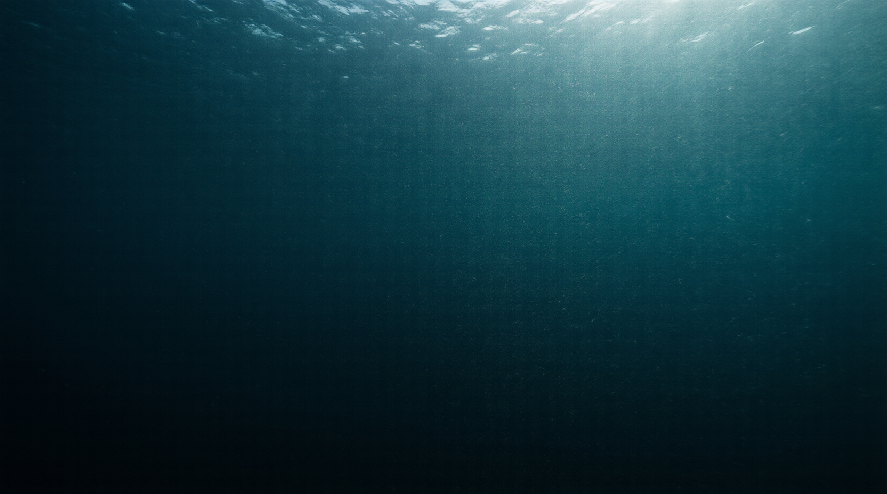
CHAPTER 01
01
Into the Food Web
Entry and trophic transfer of microplastics in the marine food chain
4 / 13
Notes:
Part one. Before we ask how much is in our food, we follow the particles from the water upward through the marine food web.

Slide 5
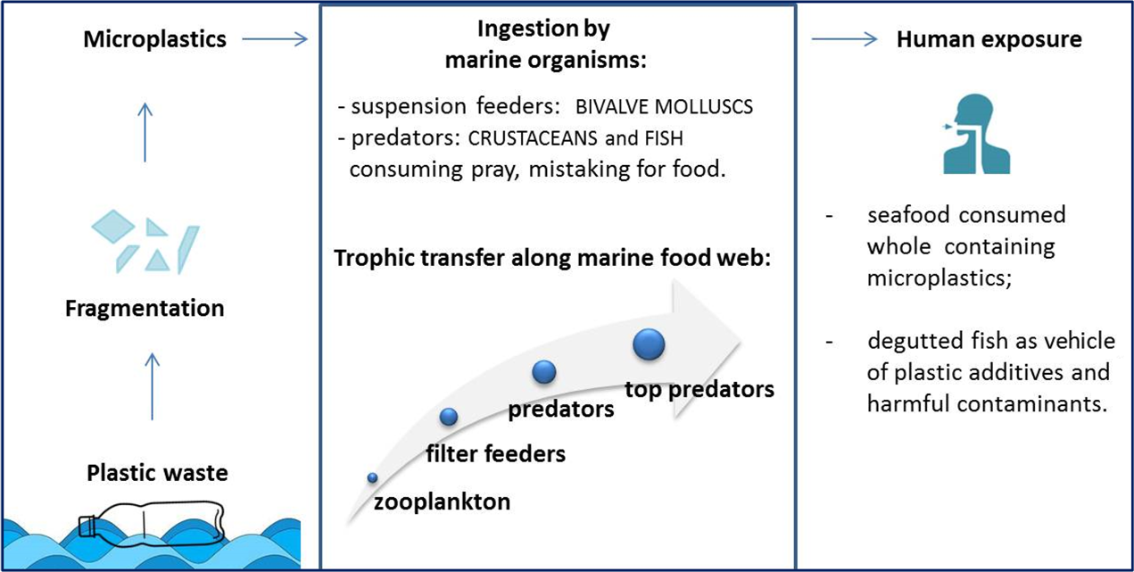
02
TROPHIC TRANSFER
From Water Column to Apex Predator
Figure 1 — microplastic transfer along marine trophic levels and human exposure.
Entry at the base: particles accumulate in sea-sediment surfaces, phytoplankton
and subsurface layers, then are taken up by zooplankton (Chaetognatha, Copepoda,
Salpida).
Stepwise transfer: plankton-feeding fish and invertebrates ingest them, and higher
predators consume those prey — passing particles up each trophic level.
Trojan-carrier effect: particles leach plastic additives and adsorb persistent organic
pollutants (POPs) from the surrounding water.
Cost to marine life: physical damage, inflammation, gastrointestinal obstruction,
impaired immune and stress response, and reduced growth.
Figure 1 — transfer from sediment and phytoplankton through zooplankton and fish
to humans.
5 / 13
Notes:
Look at Figure 1 from the paper. Microplastics settle into sediment and sit among phytoplankton at the very base of the food web. Zooplankton such as copepods and chaetognaths eat them, small planktivorous fish eat the plankton, and larger predators eat those fish. At every step the particles move upward, and because they can leach additives and adsorb persistent organic pollutants, they ride the chain all the way to the top - to us.

Slide 6
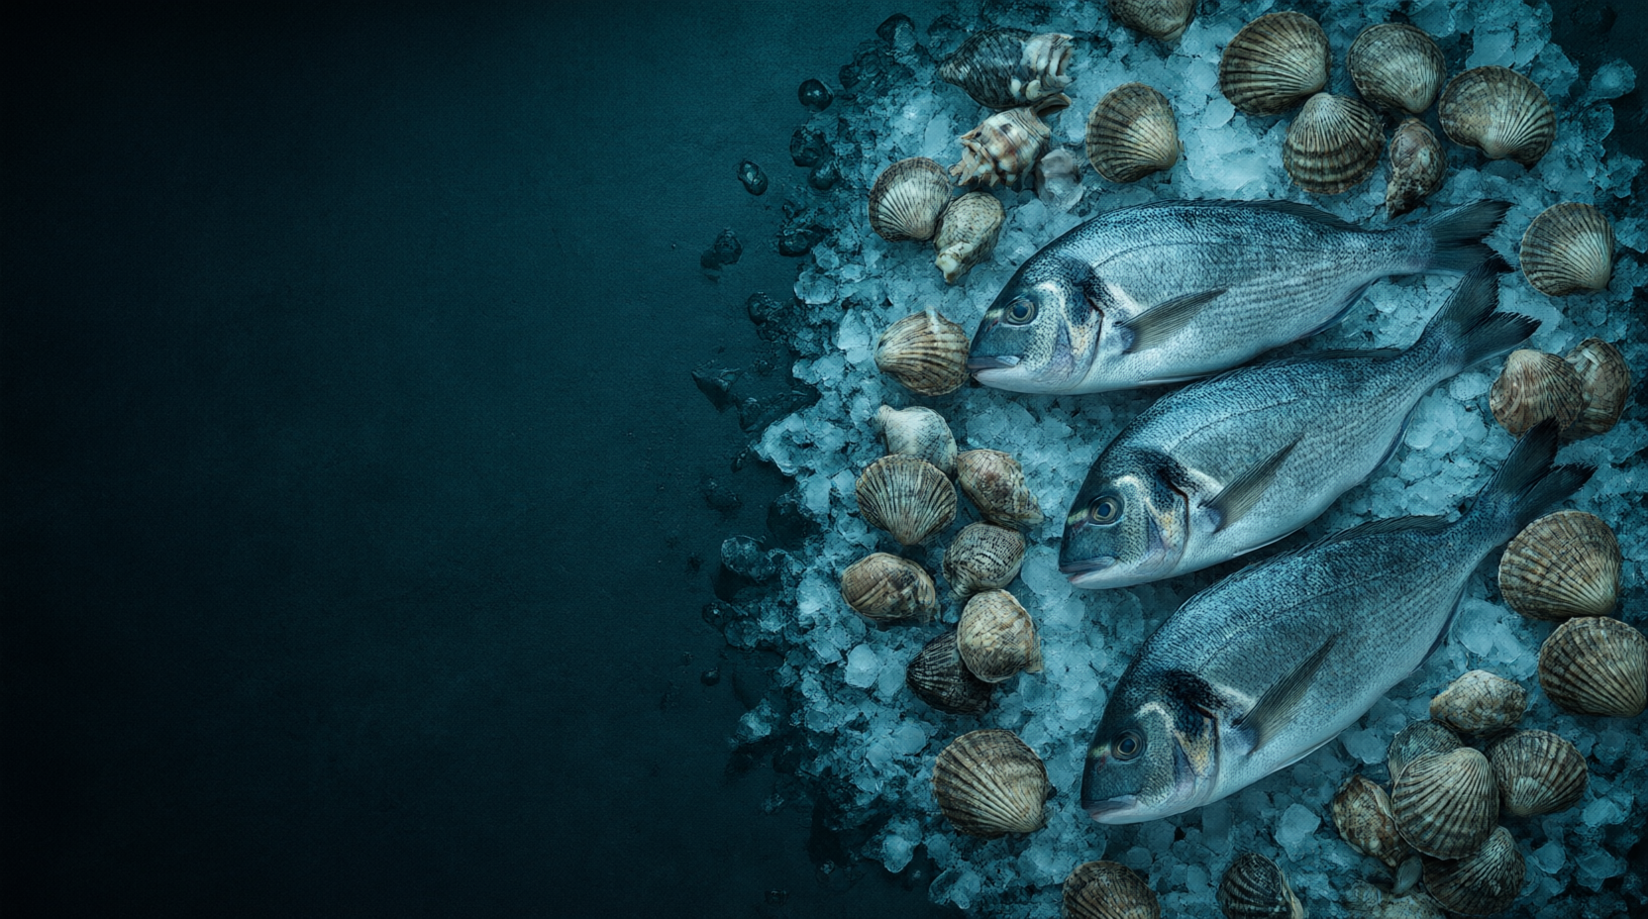
CHAPTER 02
02
Which Seafood, and Why
Feeding strategies, occurrence levels and species as
bioindicators
6 / 13
Notes:
Part two. Not every species carries the same load. The difference comes down to one thing - how the animal eats.

Slide 7
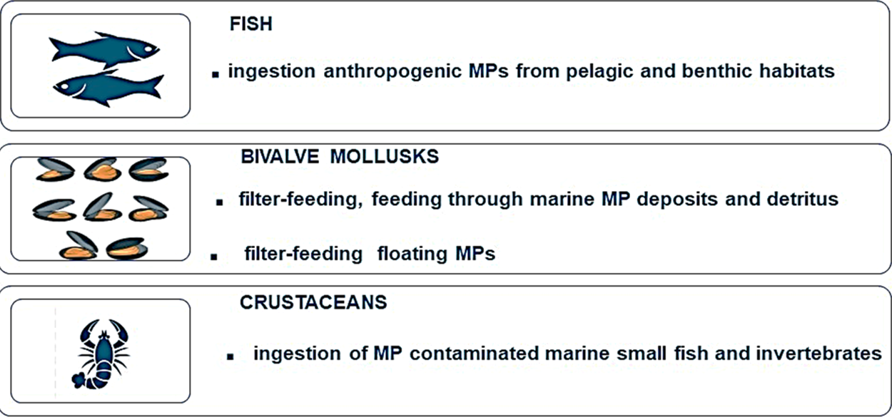
03
FEEDING STRATEGIES
One Factor Rules: How the Animal Eats
Figure 2 – fish, bivalve and crustacean feeding strategies versus microplastic occurrence.
Fish
Selective feeders rarely ingest plastic, but smaller particles defeat their
discrimination; opportunistic hunters such as Atlantic cod and large
predators (bluefin tuna, swordfish) face both primary and prey-linked
exposure.
Bivalves
Filter and deposit feeders retain many sizes; 2–10 µm particles
move from the gut into the circulatory system — 3–5 fibres/10 g in
Belgian mussels, 2–11 items/g in commercial bivalves.
Crustaceans
Swimming species ingest more than seabed dwellers; female
lobsters retain more than males (less frequent molting), and
shrimp eaten whole carry their gut contents straight to the plate.
Figure 2 — trophic uptake of microplastics by feeding strategy.
7 / 13
Notes:
Figure 2 lays out the three feeding groups. Fish that select their food rarely eat plastic, but as particles shrink they can no longer tell food from debris - opportunistic hunters like Atlantic cod eat almost anything. Bivalve molluscs filter-feed indiscriminately: particles of 2 to 10 micrometres move from the gut into the circulatory system for long-term storage. Crustaceans that swim take up more than bottom-dwellers, and because shrimp are eaten whole, their gut content reaches us too.

Slide 8
OCCURRENCE DATA
04
How Much Is Out There
Share of samples containing microplastics, by commercial species (Table 1, FAO list; Barboza et al., 2018).
MP occurrence rate by species (% of samples)
Wide spread
Top of the chart
The pattern
From ~2% (Atlantic herring) up to 80% (round scad).
Anchovy and mackerel exceed 70% of samples.
Filter- and plankton-feeders carry the highest load.
8 / 13
Notes:
Table 1 in the review lists commercial species from the FAO list, and Figure here shows the share of samples that tested positive. The range is enormous - from about 2% in Atlantic herring to 80% in round scad, with Japanese anchovy and chub mackerel above 70%. This spread is exactly what the feeding-strategy story predicts: filter- and plankton-feeding species dominate the top of the chart.

Slide 9
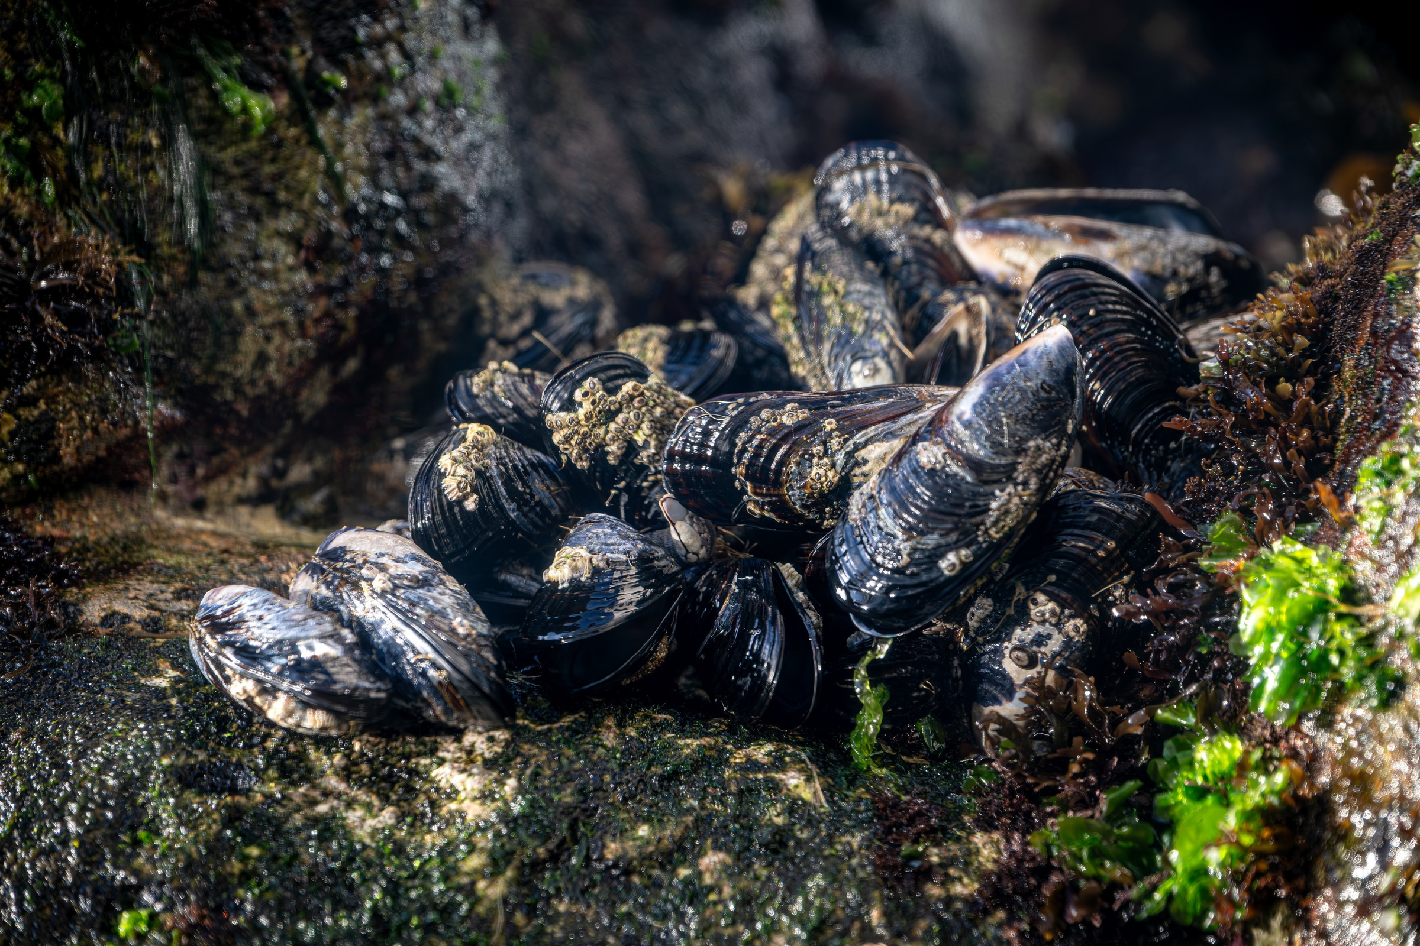
05
BIOINDICATORS
Living Monitors of Pollution
Certain species are proposed as bioindicators because their load reflects their environment.
Mussels (Mytilus spp.): widely distributed and tolerant, filter-feeders directly
exposed, with a positive correlation between particles in tissue and surrounding water;
eaten whole, they are also a major dietary exposure source.
Asian clam (Corbicula fluminea): a widespread invasive species proposed as a
bioindicator for freshwater systems.
Demersal fish: because sediments are the sink and end-point for microplastics,
bottom-living species (red mullet, Solea spp., hake) serve as small-scale indicators of
benthic contamination.
Blue mussels on coastal rocks
Notes:
Because they filter-feed and are eaten whole, mussels are the classic sentinel species - the plastic in their tissues tracks the plastic in the water. In freshwater, the invasive Asian clam plays the same role. And because sediments are the ultimate sink for microplastics, bottom-living demersal fish such as red mullet, sole and hake act as small-scale indicators of seafloor contamination.

Slide 10

CHAPTER 03
03
What It Means for Us
Human exposure, health effects and the open research questions
10 / 13
Notes:
Part three. If the chain is real, then we are at its end. So how much do we actually take in, and what could it do to us?

Slide 11
06
Exposure & Health
What Ends Up in Us
Estimated dietary intake of 39,000–52,000 particles/person/year; ingestion dominates all other routes.
Estimated annual intake by source
particles / person / year · sea salt shown at its upper bound (range 37–1,000)
Physical effects
Enhanced inflammation, oxidative stress, cell damage and size-related
toxicity; chronic inflammation raises neoplasia risk.
Chemical effects
Particles transfer manufacturing additives, plasticisers and persistent
organic pollutants into the body.
Microbial effects
Particles can act as vectors for pathogens and as rafts for alien species
across marine environments.
11 / 13
Notes:
Ingestion of food is the main human route, with an estimated intake of 39,000 to 52,000 plastic particles per person per year. Shellfish alone contribute about 11,000, tap water about 4,000 and sea salt somewhere between 37 and 1,000. Inhaled particles add 26 to 130 a day. The risks are physical - inflammation and oxidative stress - chemical, from additives and plasticisers, and microbial, as particles can carry pathogens. But the data are still too thin to fix a firm health risk.

Slide 12
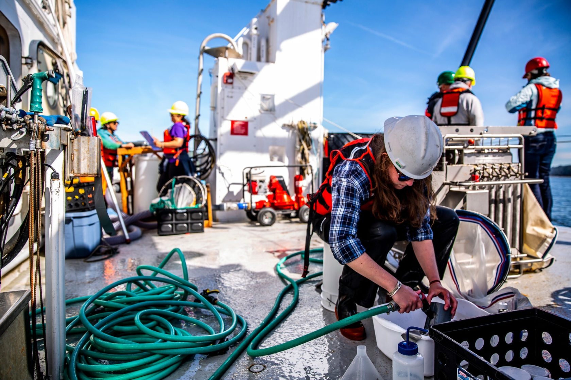
07
PERSPECTIVES
The Frontier of the Science
The field is rich in detections but too scattered for a solid risk assessment.
Data gaps
Standard sampling protocols, large representative sample sets, and a suitable indicator
species are all still missing.
Future challenges
Standardized monitoring to harmonize laboratory procedures; traceability of particle fate
in seafood; and the effect of cooking on desorption and bioaccessibility.
Policy context
Microplastic monitoring is an objective of the EU Marine Strategy Framework Directive,
with Good Environmental Status recommended to member states by 2020.
The stake
Plastic pollution concerns food security, food safety and human health together.
Fieldwork is where the answer begins: standardized marine sampling is the field’s most
urgent need.
Notes:
This is where the review ends - with a caution. The science is still uneven: protocols differ, samples are not always representative, and the link to human health effects is incomplete. The authors call for standardized monitoring methods so data can finally be compared, for traceability of where particles go inside contaminated seafood, and for study of how cooking changes what we actually absorb. Plastic pollution touches food security, food safety and human health at once - and the EU Marine Strategy Framework Directive already asks member states to reach Good Environmental Status.

Slide 13
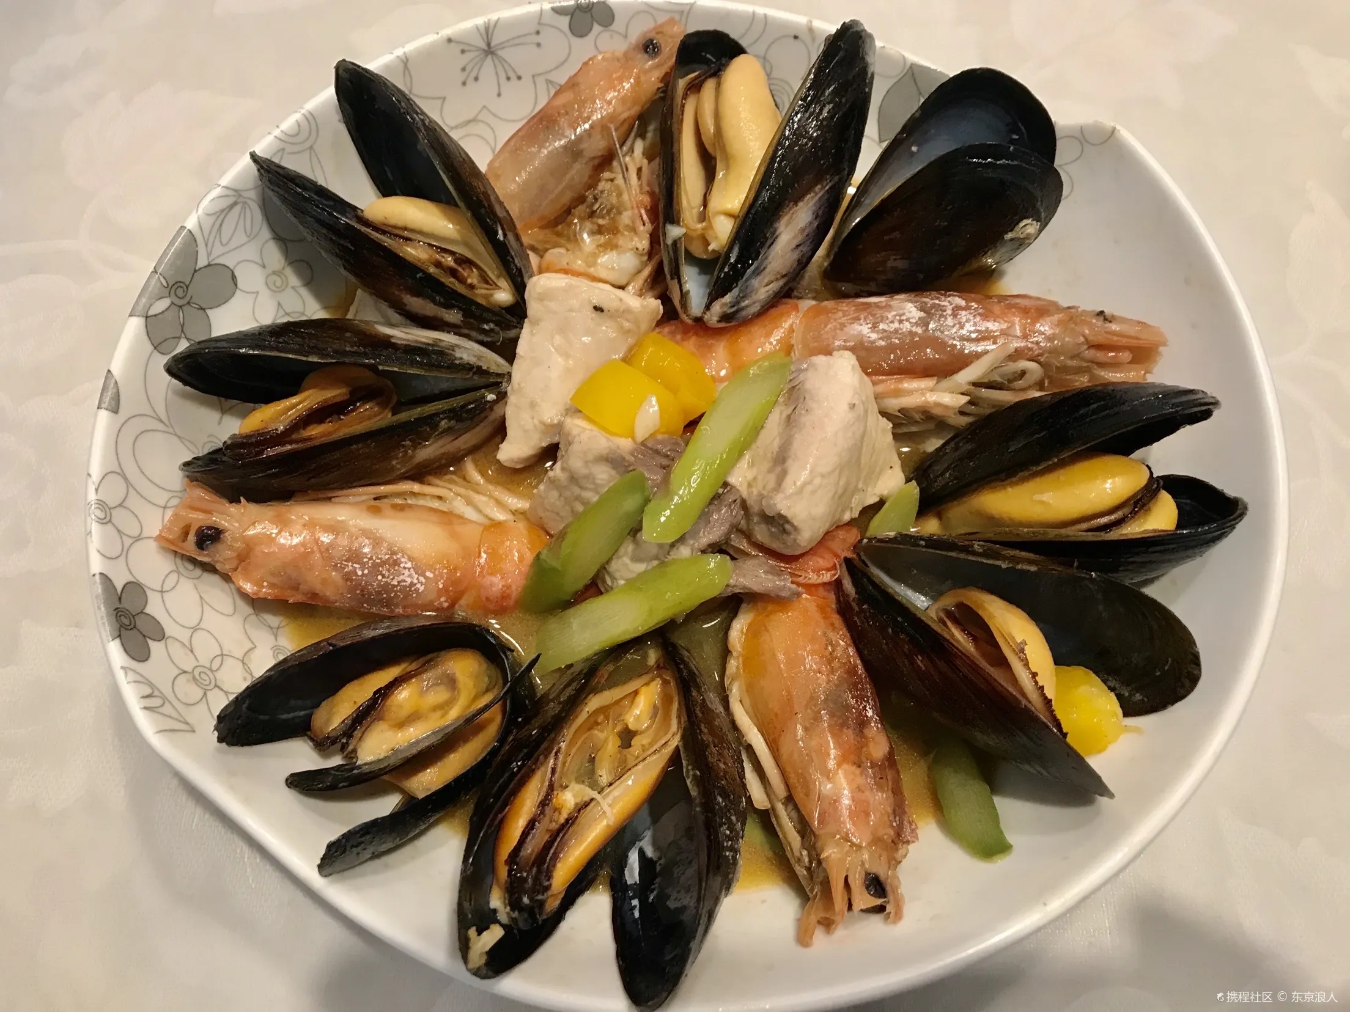
Summary · Key Takeaways
08
Microplastics are already on our plates
Ubiquitous in the ocean, transferred up the food web, already in our diet — but the risk is still unquantified.
01
Ubiquitous entry
02
How they eat
Microplastics (0.1–5000 µm) enter the marine food web at its
base and transfer up trophic levels to top predators — and to
us.
Occurrence spans roughly 2%–80% across species; filter-
feeding bivalves and whole-eaten shellfish carry the most.
03
Exposure is real
04
The verdict is open
Ingestion is the main human route at 39,000–52,000
particles/person/year, with physical, chemical and microbial
pathways of concern.
Data gaps block a solid risk assessment — the priority now is
standardized monitoring and harmonized methods.
FROM OCEAN TO PLATE
Notes:
So, to close: microplastics are everywhere and they climb the food web onto our plates. How much a species carries depends on how it eats, with filter-feeding bivalves and whole-eaten shellfish at the top. We take in tens of thousands of particles a year, with plausible physical, chemical and microbial risks - yet the evidence is still too scattered for a firm verdict. The way forward is standardization: better monitoring, the right indicator species, and a harmonized way to assess risk.

